Slide 2
Overview
Part 1 - Storage Elements and Sequential Circuit Analysis
Part 2- Sequential Circuit Design
    Specification
    Formulation
    State Assignment
    Flip-Flop Input and Output Equation Determination
    Verification
Part 3 – State Machine Design
Chapter 5 - Part 2 <number>

Slide 3
The Design Procedure
Specification
Formulation - Obtain a state diagram or state table
State Assignment - Assign binary codes to the states
Flip-Flop Input Equation Determination - Select flip-flop types and derive flip-flop equations from next state entries in the table
Output Equation Determination - Derive output equations from output entries in the table
Optimization - Optimize the equations
Technology Mapping - Find circuit from equations and map to flip-flops and gate technology
Verification - Verify correctness of final design
Chapter 5 - Part 2 <number>

Slide 4
Specification
Component Forms of Specification
  Written description
  Mathematical description
  Hardware description language*
  Tabular description*
  Equation description*
  Diagram describing operation (not just structure)*
Relation to Formulation
  If a specification is rigorous at the binary level (marked with * above), then all or part of formulation may be completed
Chapter 5 - Part 2 <number>

Slide 5
Formulation: Finding a State Diagram
A state is an abstraction of the history of the past applied inputs to the circuit (including power-up reset or system reset).
  The interpretation of “past inputs” is tied to the synchronous operation of the circuit. E. g., an input value (other than an asynchronous reset) is measured only during the setup-hold time interval for an edge-triggered flip-flop.
Examples:
  State A represents the fact that a 1 input has occurred among the past inputs.
  State B represents the fact that a 0 followed by a 1 have occurred as the most recent past two inputs.
Chapter 5 - Part 2 <number>

Slide 6
Formulation: Finding a State Diagram
In specifying a circuit, we use states to remember meaningful properties of past input sequences that are essential to predicting future output values.
A sequence recognizer is a sequential circuit that produces a distinct output value whenever a prescribed pattern of input symbols occur in sequence, i.e, recognizes an input sequence occurence.
We will develop a procedure specific to sequence recognizers to convert a problem statement into a state diagram.
Next, the state diagram, will be converted to a state table from which the circuit will be designed.
Chapter 5 - Part 2 <number>

Slide 7
Sequence Recognizer Procedure
To develop a sequence recognizer state diagram:
  Begin in an initial state in which NONE of the initial portion of the sequence has occurred (typically “reset” state).
  Add a state that recognizes that the first symbol has occurred.
  Add states that recognize each successive symbol occurring.
  The final state represents the input sequence (possibly less the final input value) occurence.
  Add state transition arcs which specify what happens when a symbol not in the proper sequence has occurred.
  Add other arcs on non-sequence inputs which transition to states that represent the input subsequence that has occurred.
The last step is required because the circuit must recognize the input sequence regardless of where it occurs within the overall sequence applied since “reset.”.
Chapter 5 - Part 2 <number>

Slide 8
State Assignment
Each of the m states must be assigned a unique code
Minimum number of bits required is n such that
n ≥ log₂ m
where x is the smallest integer ≥ x
There are useful state assignments that use more than the minimum number of bits
There are 2^{n} - m unused states
Chapter 5 - Part 2 <number>

Slide 9
Sequence Recognizer Example
Example: Recognize the sequence 1101
  Note that the sequence 1111101 contains 1101 and "11" is a proper sub-sequence of the sequence.
Thus, the sequential machine must remember that the first two one's have occurred as it receives another symbol.
Also, the sequence 1101101 contains 1101 as both an initial subsequence and a final subsequence with some overlap, i. e., 1101101 or 1101101.
And, the 1 in the middle, 1101101, is in both subsequences.
The sequence 1101 must be recognized each time it occurs in the input sequence.
Chapter 5 - Part 2 <number>

Slide 10
Example: Recognize 1101
Define states for the sequence to be recognized:
  assuming it starts with first symbol,
  continues through each symbol in the sequence to be recognized, and
  uses output 1 to mean the full sequence has occurred,
  with output 0 otherwise.
Starting in the initial state (Arbitrarily named "A"):
  Add a state that recognizes the first "1."
  State "A" is the initial state, and state "B" is the state which represents the fact that the "first" one in the input subsequence has occurred. The output symbol "0" means that the full recognized sequence has not yet occurred.
1/0
A
B
Chapter 5 - Part 2 <number>

Slide 11
Example: Recognize 1101 (continued)
After one more 1, we have:
  C is the state obtained when the input sequence has two "1"s.
Finally, after 110 and a 1, we have:
  Transition arcs are used to denote the output function (Mealy Model)
  Output 1 on the arc from D means the sequence has been recognized
  To what state should the arc from state D go? Remember: 1101101 ?
  Note that D is the last state but the output 1 occurs for the input applied in D. This is the case when a Mealy model is assumed.
A
1/0
1/0
B
C
1/0
1/0
0/0
1/1
A
B
C
D
Chapter 5 - Part 2 <number>

Slide 12
Example: Recognize 1101 (continued)
1/0
1/0
0/0
1/1
A
B
C
D
Clearly the final 1 in the recognized sequence 1101 is a sub-sequence of 1101. It follows a 0 which is not a sub-sequence of 1101. Thus it should represent the same state reached from the initial state after a first 1 is observed. We obtain:
1/0
1/0
0/0
A
B
C
D
1/1
Chapter 5 - Part 2 <number>

Slide 13
Example: Recognize 1101 (continued)
1/0
1/0
0/0
A
B
C
D
1/1
The state have the following abstract meanings:
  A: No proper sub-sequence of the sequence has occurred.
  B: The sub-sequence 1 has occurred.
  C: The sub-sequence 11 has occurred.
  D: The sub-sequence 110 has occurred.
  The 1/1 on the arc from D to B means that the last 1 has occurred and thus, the sequence is recognized.
Chapter 5 - Part 2 <number>

Slide 14
Example: Recognize 1101 (continued)
The other arcs are added to each state for inputs not yet listed. Which arcs are missing?
Answer:
"0" arc from A
"0" arc from B
"1" arc from C
"0" arc from D.
1/0
1/0
0/0
A
B
C
D
1/1
Chapter 5 - Part 2 <number>

Slide 15
Example: Recognize 1101 (continued)
State transition arcs must represent the fact that an input subsequence has occurred. Thus we get:
Note that the 1 arc from state C to state C implies that State C means two or more 1's have occurred.
0/0
1/0
1/0
1/0
0/0
A
B
C
D
0/0
1/1
0/0
Chapter 5 - Part 2 <number>

Slide 16
Formulation: Find State Table
From the State Diagram, we can fill in the State Table.
There are 4 states, one input, and one output. We will choose the form with four rows, one for each current state.
From State A, the 0 and 1 input transitions have been filled in along with the outputs.
0/0
0/0
1/0
1/0
1/0
0/0
1/0
A
B
C
D
0/0
1/1
0/0
Present
Next State
Output
State
x=0 x=1
x=0 x=1
A
A
B
0
0
B
C
D
Chapter 5 - Part 2 <number>

Slide 17
Formulation: Find State Table
From the state diagram, we complete the
state table.
What would the state diagram and state table look like for the Moore model?
0/0
1/0
1/0
1/0
0/0
A
B
C
D
0/0
1/1
Present
Next State
Output
0/0
State
x=0 x=1
x=0 x=1
A
A B
0 0
B
A C
0 0
C
D C
0 0
D
A B
0 1
Chapter 5 - Part 2 <number>

Slide 18
Example: Moore Model for Sequence 1101
For the Moore Model, outputs are associated with states.
We need to add a state "E" with output value 1 for the final 1 in the recognized input sequence.
  This new state E, though similar to B, would generate an output of 1 and thus be different from B.
The Moore model for a sequence recognizer usually has more states than the Mealy model.
Chapter 5 - Part 2 <number>

Slide 19
Example: Moore Model (continued)
We mark outputs on states for Moore model
Arcs now show only state transitions
Add a new state E to produce the output 1
Note that the new state, E produces the same behavior in the future as state B. But it gives a different output at the present time. Thus these states do represent a different abstraction of the input history.
0
1
1
1
0
A/0
B/0
C/0
D/0
0
1
1
0
E/1
0
Chapter 5 - Part 2 <number>

Slide 20
Example: Moore Model (continued)
The state table is shown below
Memory aid re more state in the Moore model: “Moore is More.”
0
1
1
1
0
A/0
B/0
C/0
D/0
0
1
1
0
E/1
0
Present
Next State
Output
State
x=0 x=1
y
A
A
B
0
B
A
C
0
C
D
C
0
D
A
E
0
E
A
C
1
Chapter 5 - Part 2 <number>

Slide 21
State Assignment – Example 1
Present
Next State
Output
State
x=0 x=1
x=0 x=1
A
A
B
0
0
B
A
B
0
1
Chapter 5 - Part 2 <number>

Slide 22
State Assignment – Example 2
Present
Next State
Output
State
x=0 x=1
x=0 x=1
A
A B
0 0
B
A C
0 0
C
D C
0 0
D
A B
0 1
Chapter 5 - Part 2 <number>

Slide 23
State Assignment – Example 2 (continued)
Counting Order Assignment: A = 0 0, B = 0 1, C = 1 0, D = 1 1
The resulting coded state table:
Present State | Next State x = 0 x = 1 |  | Output x = 0 x = 1
0 0 | 0 0 | 0 1 | 0 | 0
0 1 | 0 0 | 1 0 | 0 | 0
1 0 | 1 1 | 1 0 | 0 | 0
1 1 | 0 0 | 0 1 | 0 | 1
Chapter 5 - Part 2 <number>

Slide 24
State Assignment – Example 2 (continued)
Gray Code Assignment: A = 0 0, B = 0 1, C = 1 1, D = 1 0
The resulting coded state table:
Present State | Next State x = 0 x = 1 |  | Output x = 0 x = 1
0 0 | 0 0 | 0 1 | 0 | 0
0 1 | 0 0 | 1 1 | 0 | 0
1 1 | 1 0 | 1 1 | 0 | 0
1 0 | 0 0 | 0 1 | 0 | 1
Chapter 5 - Part 2 <number>

Slide 25
Find Flip-Flop Input and Output Equations: Example 2 – Counting Order Assignment
Assume D flip-flops
Interchange the bottom two rows of the state table, to obtain K-maps for D1, D2, and Z:
D1
D2
Z
X
X
X
0
0
0
1
0
0
0
1
0
0
0
0
Y2
Y2
Y2
0
0
0
1
0
1
Y1
Y1
Y1
1
1
1
0
0
0
Chapter 5 - Part 2 <number>

Slide 26
Optimization: Example 2: Counting Order Assignment
Performing two-level optimization:
D₁ = Y₁Y₂ + XY₁Y₂
D₂ = XY₁Y₂ + XY₁Y₂ + XY₁Y₂
Z = XY₁Y₂ Gate Input Cost = 22
D1
D2
Z
X
X
X
0
0
0
1
0
0
0
1
0
0
0
0
Y2
Y2
Y2
0
0
0
1
0
0
Y1
Y1
Y1
1
1
1
0
0
1
Chapter 5 - Part 2 <number>

Slide 27
Find Flip-Flop Input and Output Equations: Example 2 – Gray Code Assignment
Assume D flip-flops
Obtain K-maps for D₁, D₂, and Z:
D1
D2
Z
X
X
X
0
0
0
1
0
0
0
1
0
1
0
0
Y2
Y2
Y2
1
1
0
1
0
0
Y1
Y1
Y1
0
0
0
1
0
1
Chapter 5 - Part 2 <number>

Slide 28
Optimization: Example 2: Assignment 2
Performing two-level optimization:
D₁ = Y₁Y₂ + XY₂ Gate Input Cost = 9
D₂ = X Select this state assignment to
Z = XY₁Y₂ complete design in slide
D1
D2
Z
X
X
X
0
0
0
1
0
0
0
1
0
1
0
0
Y2
Y2
Y2
1
1
0
1
0
0
Y1
Y1
Y1
0
0
0
1
0
1
Chapter 5 - Part 2 <number>

Slide 29
One Flip-flop per State (One-Hot) Assignment
Example codes for four states: (Y₃, Y₂, Y₁, Y₀) = 0001, 0010, 0100, and 1000.
In equations, need to include only the variable that is 1 for the state, e. g., state with code 0001, is represented in equations by Y₀ instead of
Y₃ Y₂ Y₁ Y₀ because all codes with 0 or two or more 1s have don’t care next state values.
Provides simplified analysis and design
Combinational logic may be simpler, but flip-flop cost higher – may or may not be lower cost
Chapter 5 - Part 2 <number>

Slide 30
State Assignment – Example 2 (continued)
One-Hot Assignment : A = 0001, B = 0010, C = 0100, D = 1000 The resulting coded state table:
Present State | Next State x = 0 x = 1 |  | Output x = 0 x = 1
0001 | 0001 | 0010 | 0 | 0
0010 | 0001 | 0100 | 0 | 0
0100 | 1000 | 0100 | 0 | 0
1000 | 0001 | 0010 | 0 | 1
Chapter 5 - Part 2 <number>

Slide 31
Optimization: Example 2: One Hot Assignment
Equations read from 1 next state variable entries in table:
D₀ = X(Y₀+ Y₁ + Y₃) or X Y₂
D₁ = X(Y₀+ Y₃)
D₂ = X(Y₁+ Y₂) or X(Y₀+ Y₃ )
D₃ = X Y₂
Z = XY₃ Gate Input Cost = 15
Combinational cost intermediate plus cost of two more flip-flops needed.
Chapter 5 - Part 2 <number>

Slide 32
Map Technology
Library:
  D Flip-flops
  with Reset
  (not inverted)
  NAND gates
  with up to 4
  inputs and
  inverters
Initial Circuit:
D
Y1
C
R
Z
Y2
X
D
Clock
C
R
Reset
Chapter 5 - Part 2 <number>

Slide 33
Mapped Circuit - Final Result
Y1
D
C
R
Z
Y2
X
D
Clock
C
R
Reset
Chapter 5 - Part 2 <number>

Slide 34
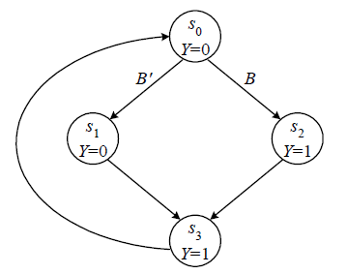
設計範例
步驟1:State Diagram
Chapter 5 - Part 2 <number>

Slide 35
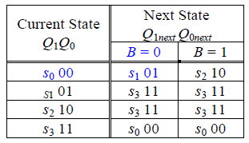
設計範例
步驟2:Next State table
Chapter 5 - Part 2 <number>

Slide 36
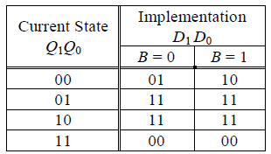
設計範例
步驟3:State Assignment
Chapter 5 - Part 2 <number>

Slide 37
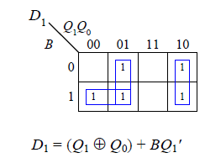
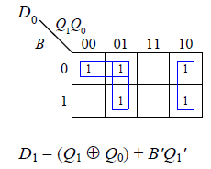
設計範例
步驟4:K-map Optimization
0
Chapter 5 - Part 2 <number>

Slide 38
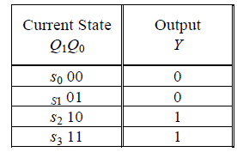
設計範例
步驟5:Output table and Output Function
Y = Q₁
Chapter 5 - Part 2 <number>

Slide 39
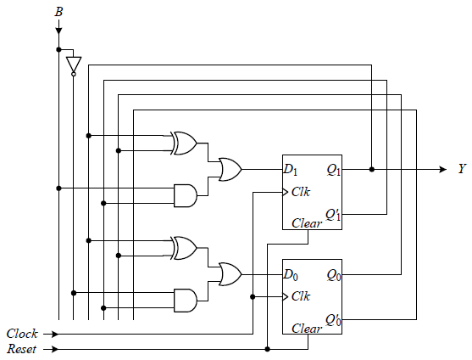
設計範例
步驟5:Resulted Circuit
Chapter 5 - Part 2 <number>

Slide 40
Terms of Use
All (or portions) of this material © 2008 by Pearson Education, Inc.
Permission is given to incorporate this material or adaptations thereof into classroom presentations and handouts to instructors in courses adopting the latest edition of Logic and Computer Design Fundamentals as the course textbook.
These materials or adaptations thereof are not to be sold or otherwise offered for consideration.
This Terms of Use slide or page is to be included within the original materials or any adaptations thereof.
Chapter 5 - Part 2 <number>

